Slide 1

Advancing with Technology
The Impact of RFiD
Lynn Fansler
DeRoyal Industries
Senior Director of Strategic Development
lfansler@deroyal.com
Mobile# 423-416-7622

Slide 2

Industry Leader in Healthcare and Technology
Established 1973-Powell, Tennessee
Manufacturer of 25,000+ products
  Surgical/Acute Care
  Orthopedic, Patient Protection and Rehabilitation
  Wound Care
40 years in Healthcare Solutions
2,000 employees
25 facilities in 5 states and 6 countries
Sales to 75 countries
Over 100 Patents

Slide 3

Increase Revenue
Decrease Costs
Vendor Neutral
Paperless Process
Increase Revenue
DecreaseCosts
Vendor Neutral
Business
Analytics
Vault
Safe
Link
Tablet

Slide 4
RFID
Radio Frequency Identification - is the use of a wireless system to transmit data from tags on items to a receiver for the purpose of identifying and tracking through the supply chain.

Slide 5
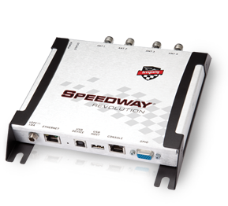

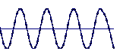

Introduction to RFiD
Basic Components
Reader
Antenna
Tag
Notes:
A reader programmer encodes a tag
RFID readers and antennas activate the tags causing it to transmit

Slide 6

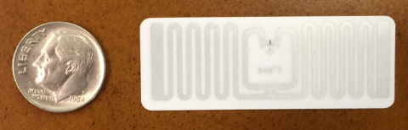
RFiD Tags
Types
Active
Semi-Passive
Passive
Frequencies
HF
UHF
Standard, non-proprietary, GS1 compliant technology
Notes:
Active RFID tags use internal batteries for power and to transmit a signal.
With battery assisted (or semi-passive) tags, they only use the power of the reader to identify that reading is in progress. Then, they use their own on-board battery to power up, run the chip and the memory and transmit and receive data.
Passive RFID tags do not have a battery and therefore rely entirely on the reader as their power source.

Slide 7
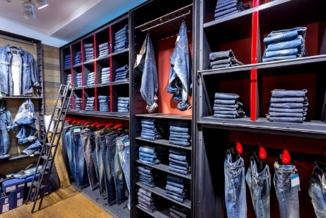
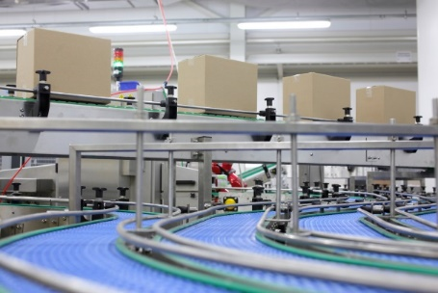

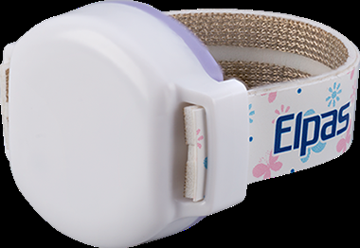

Industries Adopting RFiD
Notes:
Retail
Manufacturing
Food & Agriculture
DOD
Aerospace
Energy

Slide 8
0HIO
Zero Human Intervention in Operations
Essentially, why have people do something that can be done automatically?
Notes:
Dr. Bill Hardgrave is Dean of the School of Business at Auburn University and is also founder of the RFID Research Center at the U. of Arkansas.

Slide 9
Benefits of Using RFID
Automate inventory processes
Reduce product expiration, shrinkage, and waste
Improve patient safety & care
Increase profitability
Systematic clinical documentation
Decrease inventory costs
Remove reorder and counting processes
Reduce risk of hospital-acquired infections
Accurate Charge Capture
Full Integration

Slide 10

Asset
Tracking
Charge Capture
Automated Asset Tracking and Charge Capture

Slide 11

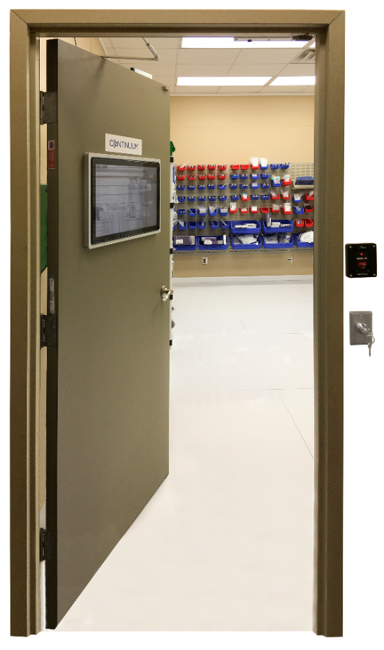
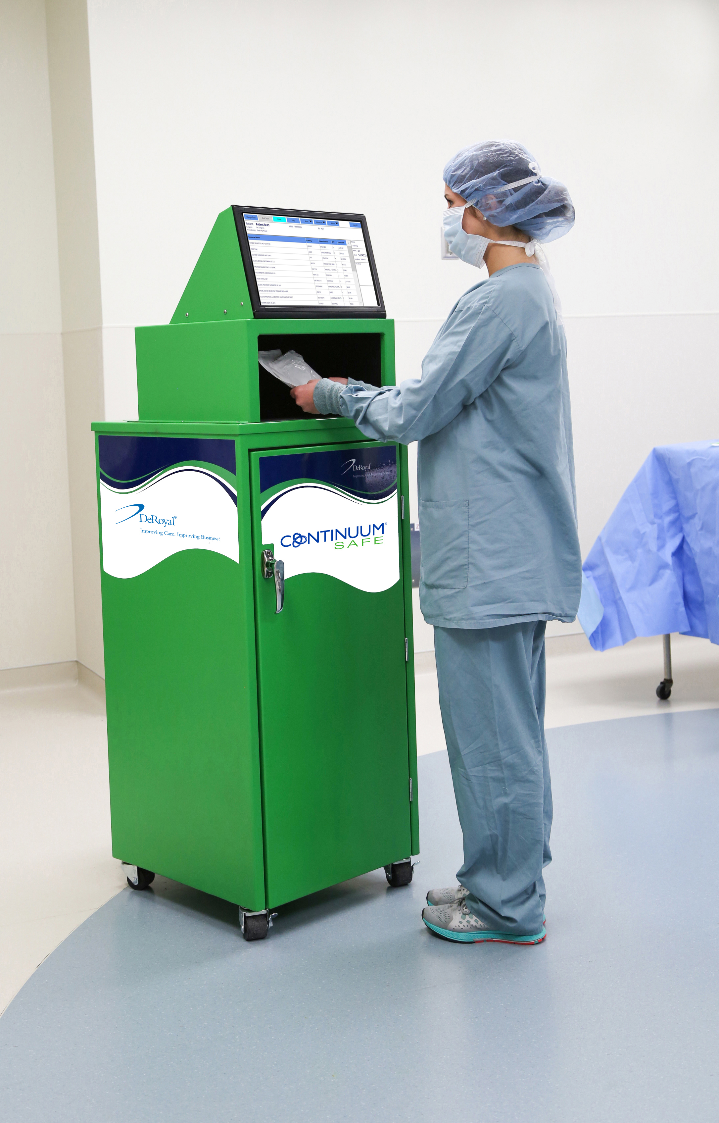
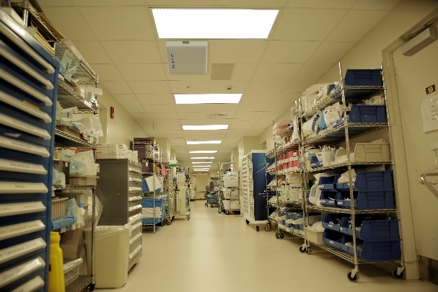




Slide 12
Who We Service
Physician Offices
Operating Rooms
Emergency Departments
Pharmacy
Cath
Interventional
Radiology

Slide 13
Challenges in Today’s Physician Office a Look at Charge Capture, Inventory Management and Key Performance Measures for DME and Injectables.
Fast Paced; High Volume
Minimal Charge Capture Measures
Difficult to Track Who Dispensed the Product
  Was it used on a patient, employee, friend
Few Business Analytic Tools/Processes
Supply Surplus/Shortages
Manual Inventory Counts
Inefficient Reorder Process
HCPCS Code Accuracy
Employee Time
Cash Items

Slide 14

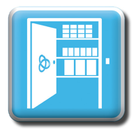
Secure Inventory Monitoring
Real-time, secure inventory
Digital chain of custody
Automated reorder & replenishment
Accountability
Expiration management
Out of stock alerts
Recommended par levels
UDI Compliance
Vaults can be configured in a current space with existing polymer shelving or as cabinets.

Slide 15

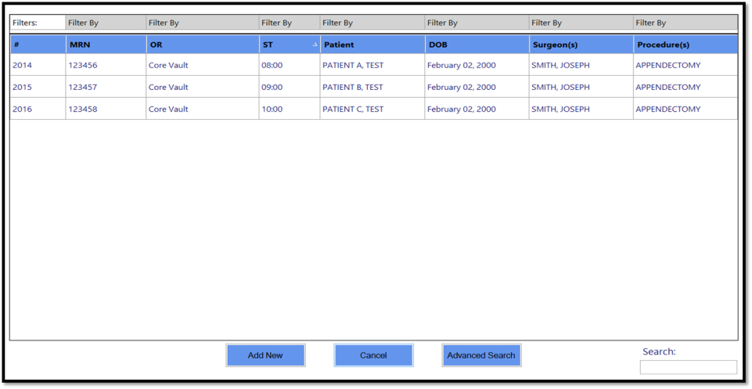
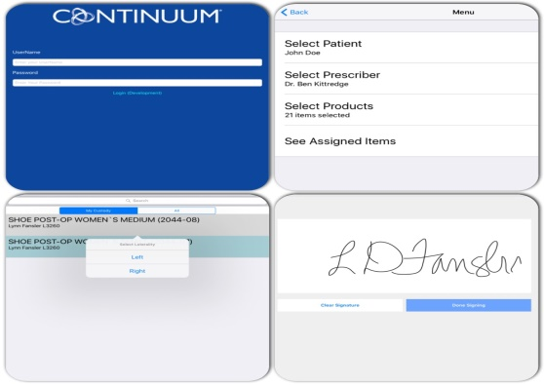
Accountability
Inventory Tracking
Links to Patient
Paperless Process

Slide 16
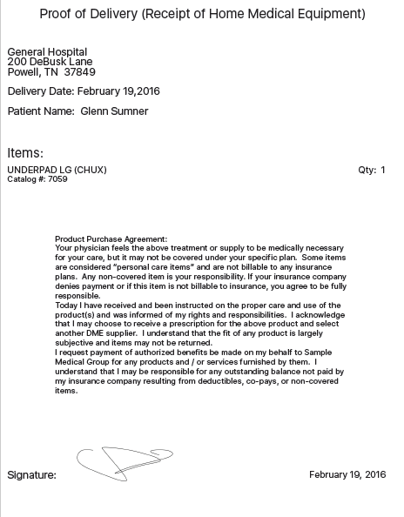
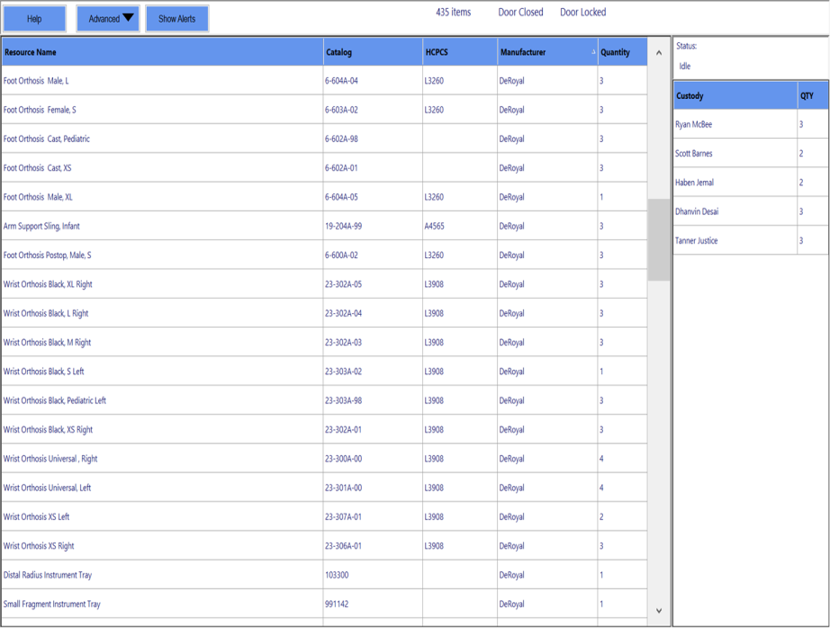
Face Sheet

Slide 17
Capture Comparison
Paper vs Continuum
2013 Paper
  766,917 (expense)
  2,097,149 (revenue)
  70% Charge Capture
  Loc 1: $914 overhead/doctor
  Loc 2: $2219 overhead/doctor
2017 Continuum
  705,453 (9 months)
  1,776,629 (9 months)
  90% Charge Capture
  Loc 1: $400 overhead/doctor
  Loc 2: $1019 overhead/doctor

Slide 18

CONTINUUM CUSTOMER COMMENTS ON BILLING INJECTABLES.
PROBLEM A: Ortho Practice audited annual billed visco supplementations against purchased viscos/remaining inventory. The results found over $200K in lost charges.
SOLUTION A: Injectables were added to the Continuum Vault and only reordered when dispensed. The billing staff uses system reports to reconcile proper claims processing.
PROBLEM B: Ortho Practice was not properly charges for visco supplementations which resulted in lost revenue.
SOLUTION B: Practice Administrator placed viscos in Continuum system to know the clinician who dispensed and accurately capture charges.

Slide 19

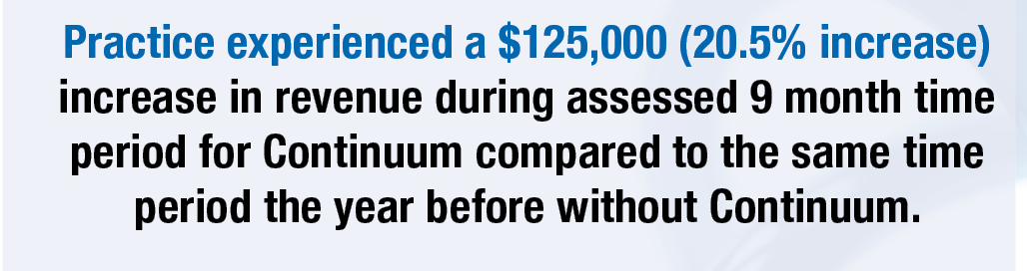
Notes:
Charge Capture Difference with automation. Total boots purchased/inventory on hand compared to billed product. 20.5%

Slide 20


Point of Use
99% accurate usage and charge capture, > 30% increase
Association of supplies and implants to specific patients
Doctor Performance Cards
Accurate case cost
Item expiration alert
Automated UDI documentation
Wasted item documentation

Slide 21

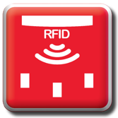
Open Inventory Monitoring
“Real-time”, open inventory
Automated inventory management
Expiration management
UDI compliance
Automatically increases/decreases inventory as it is replenished or removed
Tracks returns and restocks
Recommends more accurate par levels
Link can be configured with existing polymer shelving or with Continuum® Mobile Carts

Slide 22

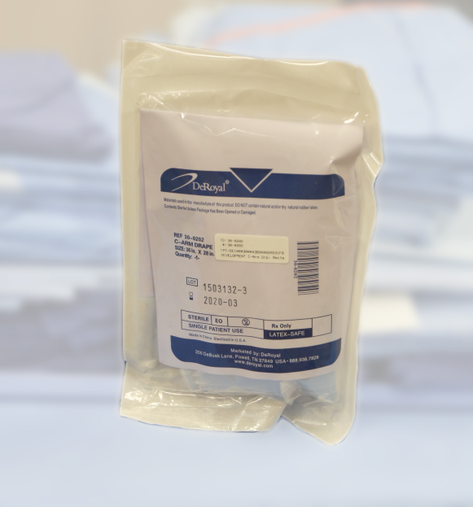
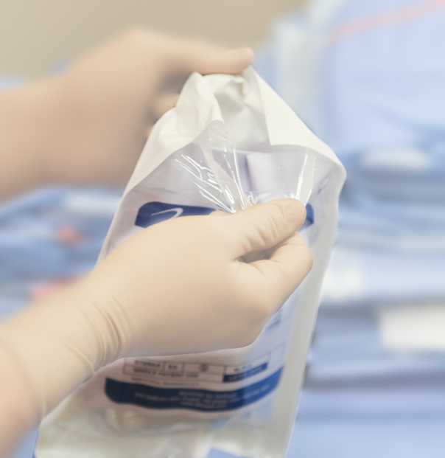
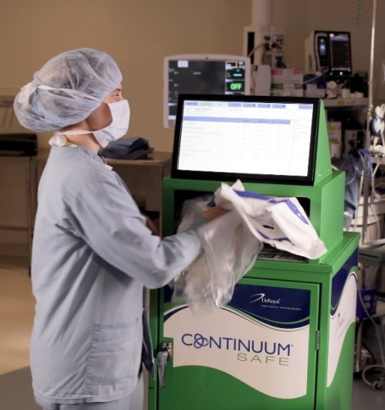
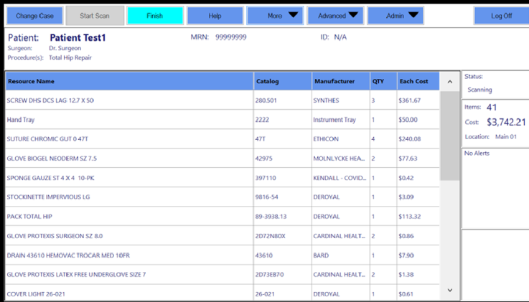

Slide 23

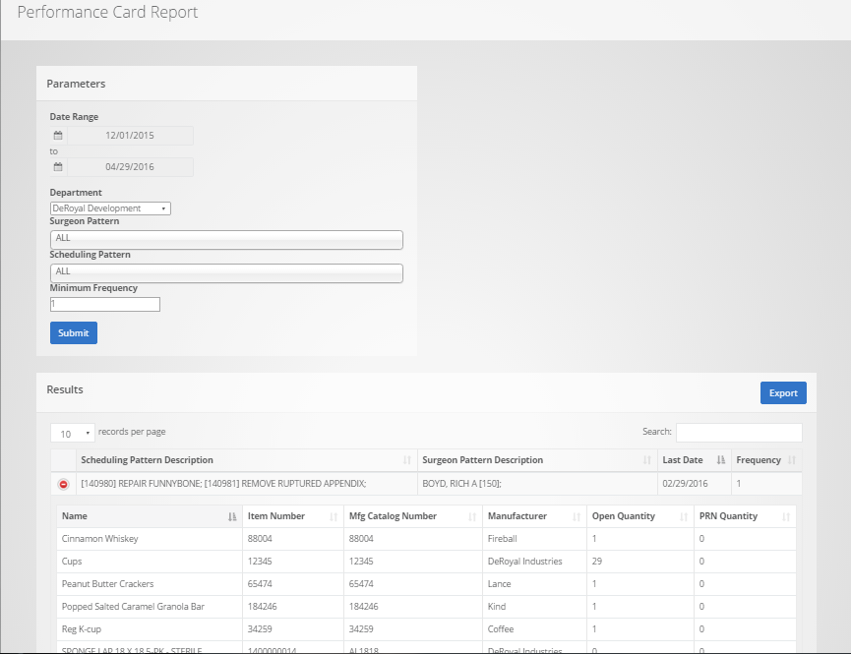
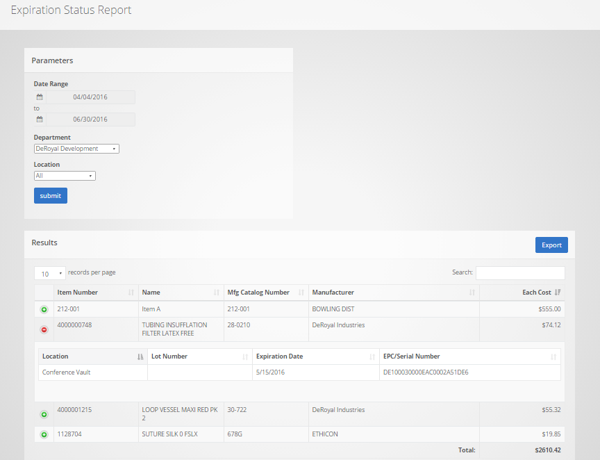
Real-Time Case Cost

Slide 24
Doctor Preference Cards
A list of supplies that hospital staff thinks a surgeon may use on a procedure.
  Guide for what supplies are pulled into a surgical case.
  Often used as the foundation for patient charge sheet
  Used for resource forecasting

Slide 25
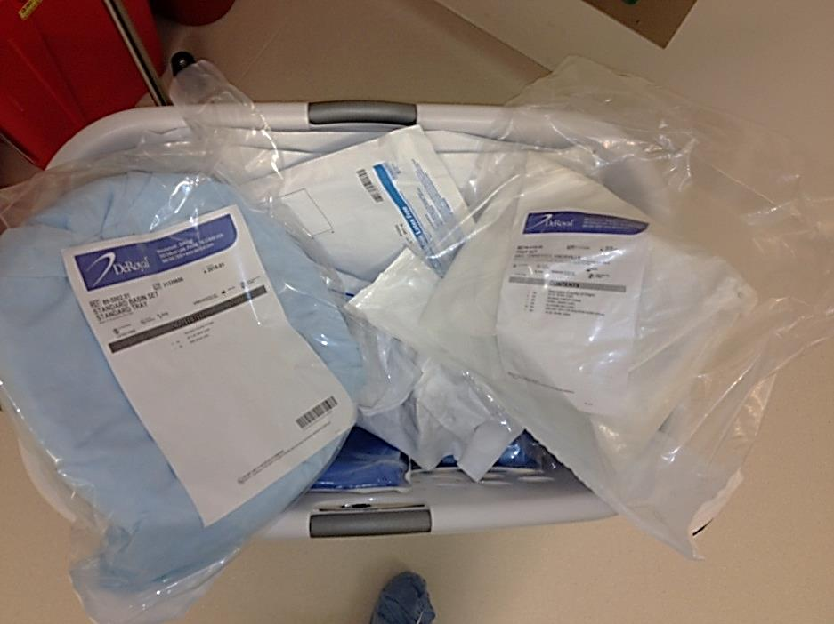
Over Pulled Items Returned to Stock
On average, 70% of items pulled for a case are returned to stock
Our distrust is very expensive.
- Emerson

Slide 26
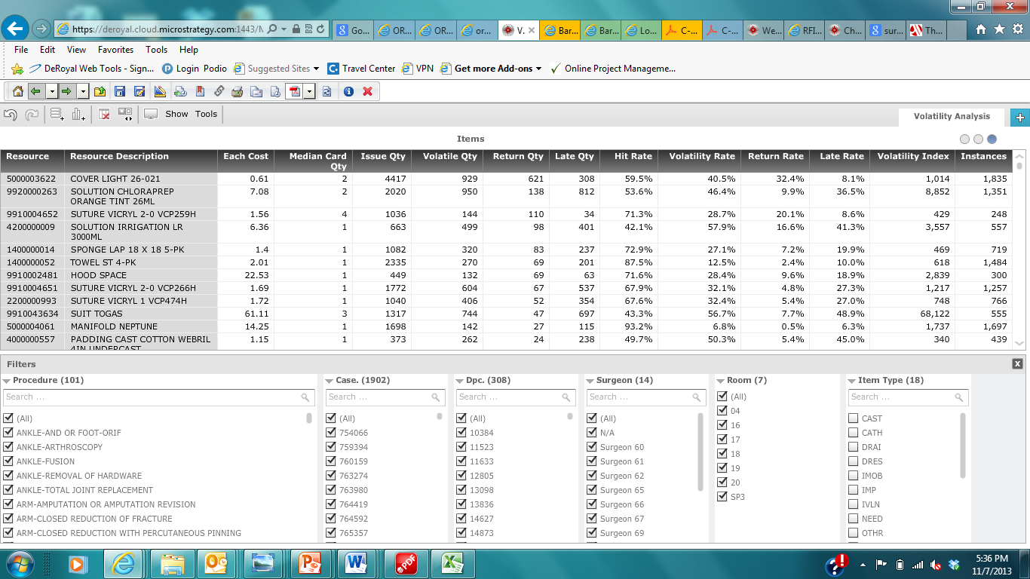
Analytics

Slide 27
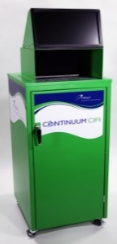
Received
Stocked
Case Pick 76347
Returned
012105467478 Lap 18x18 5pk $1.60
012105467478 Lap 18x18 5pk
$2.10
012105467478 Lap 18x18 5pk
$2.60
012105467478 Lap 18x18 5pk
$3.35
Case Pick 76521
Returned
Case Pick 76542
012105467478 Lap 18x18 5pk $3.85
012105467478 Lap 18x18 5pk $4.60
012105467478 Lap 18x18 5pk $5.10
Returned
Case Pick 77254
Returned
Case Pick 77310
012105467478 Lap 18x18 5pk
$5.85
012105467478 Lap 18x18 5pk
$6.35
012105467478 Lap 18x18 5pk
$7.10
012105467478 Lap 18x18 5pk
$7.60
Returned
Case Pick 77422
012105467478 Lap 18x18 5pk
$8.35
012105467478 Lap 18x18 5pk
$8.85
Clinical
Clerical

Slide 28
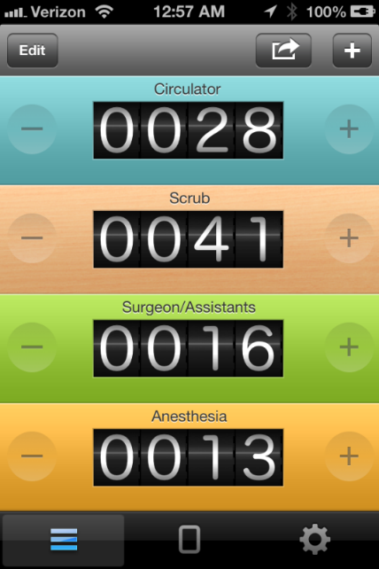
Orthopedic Case Traffic Study
Door Openings: 1 every 1.5 minutes
Total open door time during case in minutes: 10.75
Percentage of supply related openings: 30%

Slide 29

OR Traffic and Patient Safety
Issues
Increased risk of Surgical Site Infection
Contributing factor to surgical mistakes
Studies:
AORN
University of Michigan
Leeds

Slide 30
ROI Estimates
10% - Charge Capture
80%
Decrease time spent – inventory mgmt
30% - Reduce Inventory (consigned & owned)
Decrease time spent – nursing documentation
6 mins
99% - Outdated Product
80%
Decrease time spent – recall management
1% - Reduce Cost per Procedure
80%
Decrease time spent – charge audit

Slide 31
The Little Tag That Could…
More focus on the patient
Knowing where items are when needed
Eliminating manual tasks
Automating manual processes

Slide 32


Business Management
Reports
  Web based system
  User friendly formats
    Columns are sortable
    Search features
    Exported to Excel
Analytics
  Fully Integrated System-Documentation and Performance Tools
  Clinician accountability
    Clinician-product-patient
  Prescriber Usage
  Product Usage
  Lost Charge Reports
  Expired Items
  Real time inventory for managing multiple locations

Slide 33
Advancing with Technology
The Impact of RFiD
Lynn Fansler
DeRoyal Industries
Senior Director of Strategic Development
lfansler@deroyal.com
Mobile# 423-416-7622

