Slide 1
Increasing Efficiencies through Innovations in Telemedicine and Telehealth Tallahassee Memorial HealthCare
Leading our community to be the healthiest in the nation.
Lauren Faison
Administrator
Tallahassee Memorial Healthcare

Slide 2
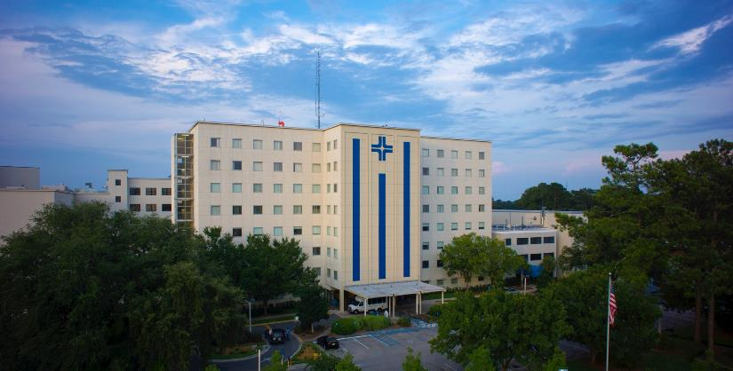
Tallahassee Memorial HealthCare
Notes:
Opened 1949 as City Hospital
Not for profit
Community Asset
Charity Care

Slide 3
Facts & Figures
772 Beds
Serving 17 Counties
Inpatients…..29,586
Outpatients…..133,046
Emergency Care….. 122,100
Births per year…..3,800
Surgeries per year…..16,400
Employees…..4,586
Physicians on medical staff…558
Employed Physicians…175+
Not-for-profit
31 physician practices
Partnerships with:
UF Health
Wolfson Children’s Hospital
Doctors’ Memorial Hospital
Weems Memorial Hospital
3 Residency Programs
Acute Care Hospital
Psychiatric Hospital
Multi-Specialty Care Centers

Slide 4
Tallahassee Memorial Healthcare
Our Mission
Transforming care. Advancing health. Improving Lives.
Our Vision
Leading our community to be the healthiest in the nation.

Slide 5
Why Telehealth? Why Now?
Healthcare reform
Change in Vision, Mission
Patient Centered Culture

Slide 6
Goals for TMH TeleHealth
Improve overall health and quality of life for patients.
Increase patient access to primary and specialty care.
Increase efficiencies within the regional health system.
Promote successful transitions in care.
Reduce readmissions and unnecessary transfers to the ED.

Slide 7
Tallahassee Memorial TeleHealth
Telemonitoring – remote monitoring of patients.
Telemedicine – connecting providers to patients through technology vs. face to face.

Slide 8
Telemonitoring
Allows providers to remotely monitor key health indicators such as weight, blood pressure, oxygen levels, glucose, and health behaviors.
Interventions are provided quickly to prevent health episodes that result in hospitalization or a visit to the ER.
Empowers the patient be an active participant in managing their own health.

Slide 9
Remote Patient Monitoring
30-90 Day Patient Monitoring
Blood Pressure
Weight
Pulse Ox
Medication Adherence
Care Plans

Slide 10
Telemonitoring Impact
Remote Monitoring pilot project:
1. 23 high E.D. utilizers where monitored for 30-60 days.
2. Nurses were able to monitor and provide timely interventions.
Results:
Visits prior to remote monitoring/interventions | Visits after remote monitoring/interventions | Impact
105 | 18 | 83%

Slide 11
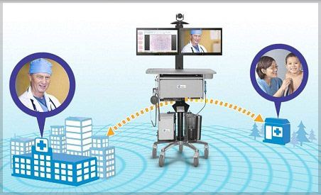
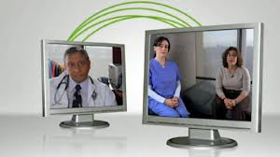
Telemedicine

Slide 12
WHAT IS TELEMEDICINE ?

Slide 13
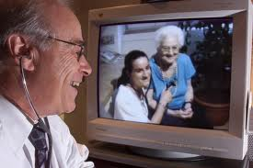
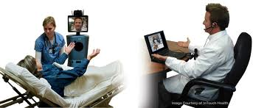
What is Telemedicine ?
A system that utilizes
technology which
allows for delivery of
quality healthcare in
a setting where the
physician (or provider
of higher level of care)
and patient are in two
different locations.

Slide 14
Telemedicine Maintains Quality
* Telemedicine does not change the way providers care for patients, but changes the delivery method for how the patient and provider communicate.

Slide 15
HOW DOES IT WORK?

Slide 16
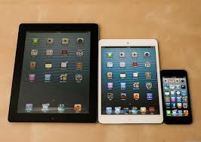
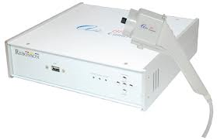
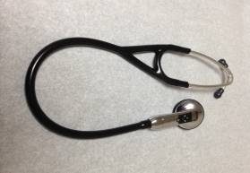
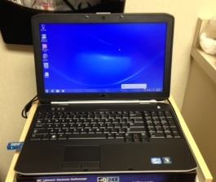
Telemedicine Equipment

Slide 17
Telemedicine Networks
Mobile platforms
Security
Cost
Internal vs. External Network

Slide 18
Making a Connection
Presenting Site
Patient
Health Professional
Consulting Provider
Primary Care Provider
Specialist

Slide 19
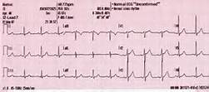
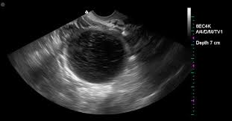
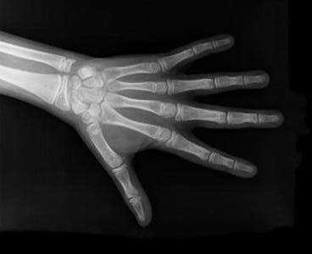
Telemedicine Capabilities
Live Videoconferencing
Store and Forward
Otoscope
Ophthalmoscope
Dermascope
Bluetooth Stethoscope
EKG
Ultrasound
X-ray

Slide 20
Uses for Telemedicine

Slide 21
Telemedicine
Specialty consults – cardiology, neurology, orthopedic, dermatology, wound care, etc.
Telepsychiatry – mental health services
Expanding transitional care
Emergency exams
Increasing access in rural communities
Increasing provider availability
Communicating with distant family members/providers

Slide 22
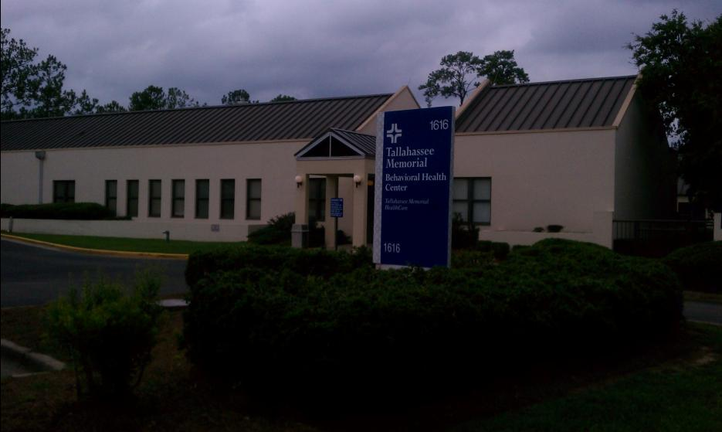
TMH Telemedicine
Expansion of Behavioral Health Services to Rural Communities
Partnership with primary care providers
Rural ED Baker Act Evaluations
Outpatient follow-up

Slide 23
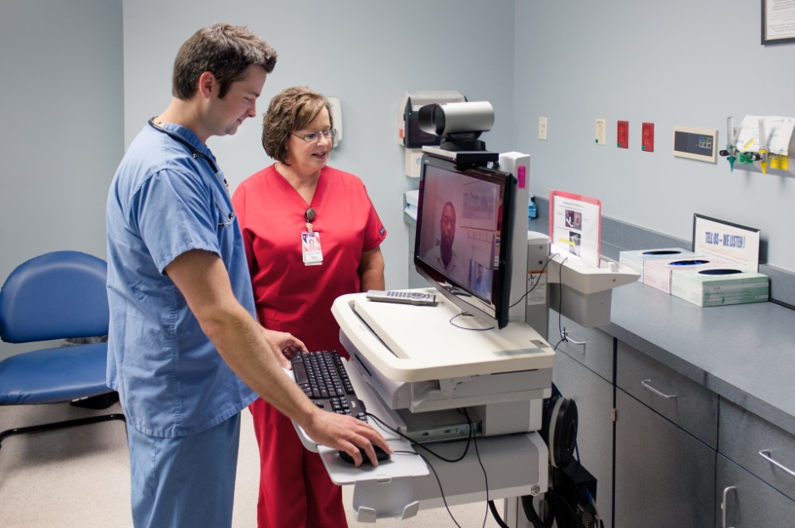
TMH Telemedicine
2. Services to Rural Hospital Partners
Doctors Memorial – Psychiatry, Dietary, Specialists, Transfers

Slide 24
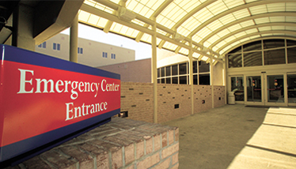
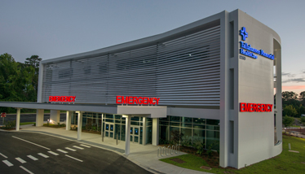
TMH Telemedicine
3. Specialty Consults
4. Expanding Transitional Care Services
5. Residency Program Training

Slide 25
TMH Telemedicine
6. Reducing unnecessary readmissions and visits to the ED by connecting Medical Directors to LTC/SNFs/Rehab Facilities.

Slide 26
The Business of Telemedicine

Slide 27
Medical Staff Considerations
Credentialing
Liability
Record-keeping
BAA/Agreements
Billing

Slide 28
Reimbursement
Medicare reimbursement: Medicare will reimburse for telemedicine visits at the same rate as a face to face for patients in rural communities. The presenting sites can also bill for a small fee.
Cash contracts: ROI for investing in telemedicine services.

Slide 29
BENEFITS

Slide 30
Provider Benefits
Increased flexibility.
Increased productivity.
Increased efficiencies.
Increased quality of life.
Expanded patient base.
Additional revenue streams.

Slide 31
Payer Benefits
Reduced costs.
Increased patient compliance.
Increased patient satisfaction.

Slide 32
Patient Benefits
Increased access to care.
Decreased transportation costs.
Increased patient safety.
Continuity of care
Care collaboration
Right care, right time, right place

Slide 33
TIPS FOR SUCCESS

Slide 34
Lessons Learned
Find physician champions.
Technology is easy, focus on protocols/processes.
Involve all levels of input.
Start small.
Identify opportunities and an implementation plan.
Identify telemedicine champion to coordinate efforts.

Slide 35
DEMO

