Slide 1
Powering the Future of Healthcare IT
Ron Machisen
Lead Systems Engineer, CSP Team
September 15, 2017
© 2016 Citrix | Confidential
Notes:
Talking Points
Today we are going to talk about a very powerful idea. “The future of work.”
We believe the way we work is the way business can win. It’s foundational. And when the way we work is all it can be, the extraordinary becomes possible—and happens.
Our conversation will center on how Citrix can partner with you to help you say YES to reimagining work.

Slide 2
Secure delivery of apps & data
Any Device, Any Location, Any Network, Any Cloud
XenApp
XenDesktop
App virtualization & VDI
XenMobile
Enterprise mobility management
ShareFile
Enterprise file sync & sharing
NetScaler
App delivery networking & SD-WAN

Slide 3
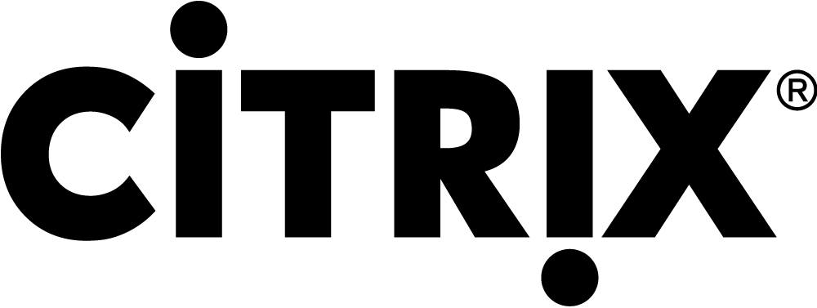
Leadership in Healthcare
10 of the top 10 U.S. News Honor Roll hospitals
88% of Epic Hyperspace installs
Cerner hosts over 250k concurrent users at hundreds of hospitals
4 million caregivers

Slide 4
Offering the world’s best integrated technology services for secure delivery of apps and data
Software Defined Networking
App Delivery Networking
VDI & App Virtualization
Enterprise Mobility
Secure delivery of apps & data
Hybrid Cloud
File Sharing
IoT
&
Analytics

Slide 5
Unifying apps and data in secure digital workspaces that enable people to work on any device, anywhere
NetScaler ADC, Gateway, SD-WAN, MAS
XenApp & XenDesktop
XenMobile
Digital Workspace
Citrix Cloud
ShareFile
Workspace IoT

Slide 6
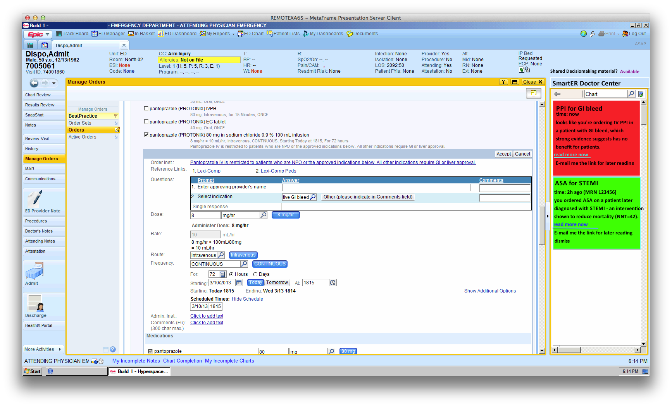
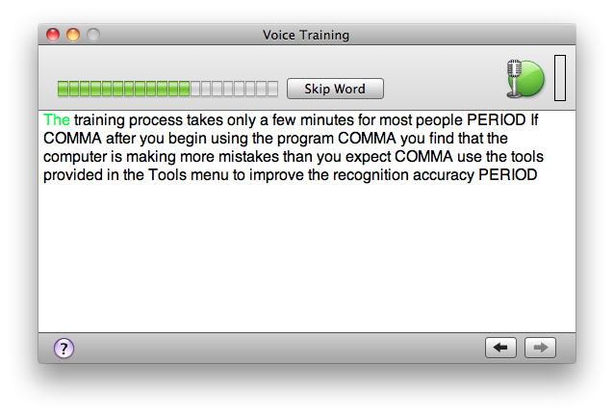
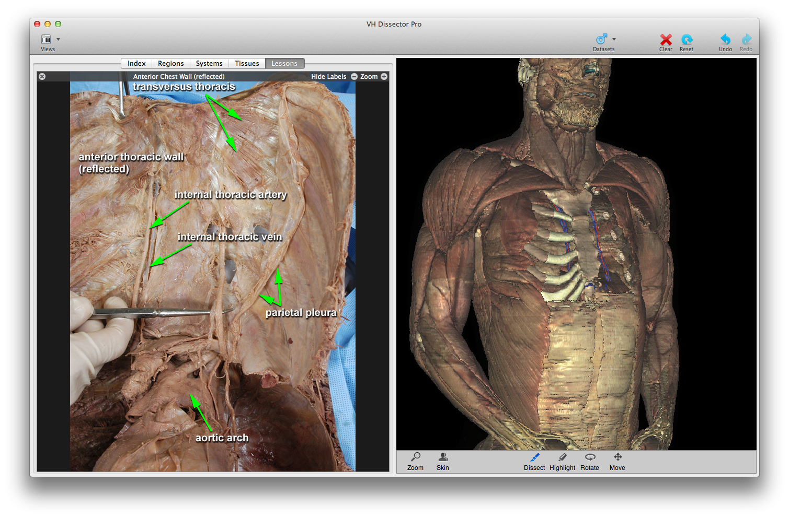
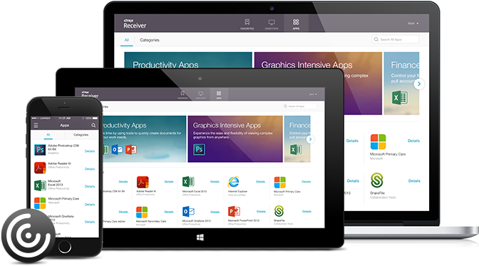
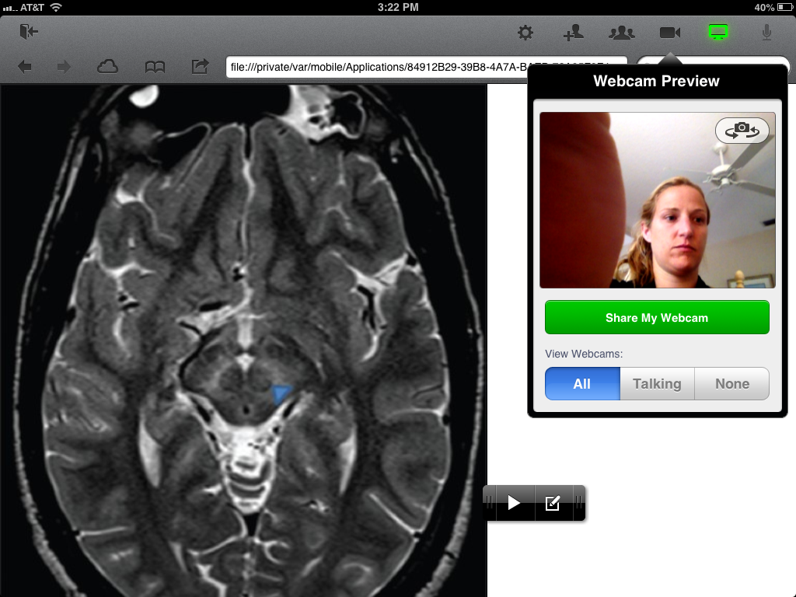
Digital Workspace
Electronic Medical Record
Dictation Software
Imaging Viewer
Access and Sharing of PHI
Productivity apps
“Anywhere, anytime, on any network”
Notes:
Because this means a doctor or a nurse, who needs to seamlessly access a variety of applications as part of one workflow, such as an EMR to check the patient to voice control/dictation software to an integrated imaging viewer, to a secure texting app or e-mail and web access, can do so in a simple and secure fashion. This can truly improve care coordination and allow clinicians to deliver the best care possible at the point of care, instead of waiting to respond when they get back to a specific imaging device or a laptop that allows them to access specific applications.
Transition: And many of our own apps play a huge role in creating additional productivity for clinicians, executives and other healthcare users…

Slide 7
Franciscan Missionaries of Our Lady Health System
The challenge
Improve clinician productivity and satisfaction
Adapt to government mandates and mitigate security risks
Address device proliferation and bring-your-own-device issues
Reduce IT costs and improve efficiency

Slide 8
“They are doctors, not IT people. They shouldn’t have to worry about the computer. We needed to get them access to the applications they need, when and where they need them.”
—Johnny Brister, Manager of Infrastructure and Technology Systems, Franciscan Missionaries of Our Lady Health System

Slide 9
Franciscan Missionaries of Our Lady Health System
The Solution
End-to-end digital workspace
Key benefits
Simplifies workflows, improves clinician satisfaction and meets CPOE needs with less than five-second logins
Saves nearly $750,000 per year
Reduces risk of HIPAA breaches
Enables support of bring-your-own-device program in less than two weeks
r solutions for tap-and-go badge access, medical-grade dictation and zero-client footprint

Slide 10
Digital Transformation in Healthcare
Freedom to create mobile workflows that improve care
Secure access to patient records and other sensitive data
Flexibility for IT to handle rapid change

Slide 11
Benefits of Digital Transformation Go Beyond Clinicians
Extending Citrix solutions to administrative staff:
Increases security
Reduces costs
Improves access & productivity
Increases timely payments

Slide 12
Typical Healthcare Customer Use Cases
Mobile Workflow
Security
IT Flexibility
Secure Access for Employees and Affiliates
Compliance Initiatives
Data Protection Initiatives
Mobile Application/Device Security
File Sync and Sharing
Clinician Mobility (Mobile Devices/BYO)
Telehealth/Telemedicine
Mobile Workstations/Thin Clients
EMR/EHR Deployment/Replacement/Consolidation
M&A/IT Consolidation
Non-clinical app delivery
EHR as a Service
Business Continuity

Slide 13
Security & Compliance
Notes:
Data breaches are #1 concern of CIOs globally
"Healthcare organizations will be the most targeted sector, with new sophisticated attacks emerging.“, Experian 2017 Data Breach Industry Forecast
Data encryption is essential to meet multiple compliance and government mandates
Network security and access is critical

Slide 14
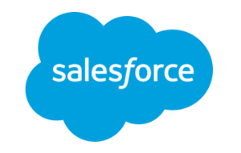
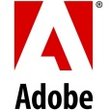
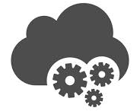
Perimeter is Expanding With a Complex Mix of Assets & Data
Endpoints
Network
Applications
Data
Mobile/BYO
Enterprise Data
File Server
WAN
Remote Workers
Cloud Data
Media
3G/4G
Email
Enterprise Endpoints
Mobile Data
VPN
VPN
Security Services
IoT/Wearables
Personal Data
Notes:
Security teams can no longer just say no, and put a big perimeter around buildings, devices they own, and their network. The workplace is mobile, and people are bringing their own devices. Data is at rest, in motion and in use across a complex matrix of targeted assets from endpoints, networks, apps and data storage. You need to prepare for conversations in your accounts that address security across this matrix.

Slide 15
Security is #1 concern

Slide 16
Citrix Advantages – Security & Compliance
Data stays in the datacenter and not on the device
Dynamic security restrictions based on device, location, time, user or resource to enforce corporate security standards
Encryption of all network traffic meeting the highest security standards
Global market leader in application delivery with most experience in keeping healthcare customer data secure

Slide 17
IT Efficiency & Flexibility

Slide 18
Driving Savings, Security and Growth
Adapt to the realities of value-based payment models
Savings
Realize the same app delivery value of EMR for other applications
Further consolidate and centralize infrastructure
Reduce cost of desktop and app upgrades & rollouts
Security
Decrease risk of data breaches
Facilitate compliance
Provide freedom to embrace mobile devices securely
Growth
More timely physician consults
Maximize reimbursements
Enable new acquisitions, affiliations and offerings

Slide 19
Helping you say YES to the future of work
Business agility
Patient
loyalty
Clinician productivity
Security & compliance
Cost & efficiency
Market expansion & acquisitions New business relationships Continuity of operations
Personalized service Improved satisfaction Seamless across channel
Employee engagement High performing virtual teams Flexible, collaborative spaces
Simpler security operations Remediation & response Compliance management
Cloud scale and economics
Unified control & management Data center modernization

Slide 20
Mobility in healthcare: transforming the care experience
In every location, on any device, at any time
!
1 a.m. “Dr. Allen” receives a phone call from the hospital and schedules an a.m. surgery for the patient from the home laptop.
8 a.m. Logs onto tablet to review patient’s MRI during the commute to the hospital
10 a.m. Arrives at hospital and logs into work desktop to check status and prep for surgery
6 p.m. Reviews patient’s post-op status on tablet during the return commute home
Notes:
This slide is about creating a vision match with your customers without mentioning a Citrix product. Product conversations will come later.
“Citrix solutions for Healthcare provide enabling technologies to allow clinicians secure 7 X 24 access to clinical information, on any device and from any location”
A mobile workspace strategy focuses on Healthcare Providers greatest asset…people
First and foremost, it’s about transforming the care experience, allowing doctors and nurses to work seamlessly, and securely across all of the locations, from whatever device they need to use at the point of care, at whatever time the patient needs them.
Citrix solutions for Healthcare provide enabling technologies to allow clinicians secure 7 X 24 access to clinical information, on any device and from any location. With a clinical mobile workspace solution from Citrix organizations can transform care, can reduce costs, and can accelerate organizational change.
Clinical impact:
Faster decisions
Better patient response
Improved care coordination
Increased patient interaction

Slide 21
Make the extraordinary possible

