Slide 1

Opt to Transform
RIT Healthcare Summit
October 2017

Slide 2
Have You Felt Like This?
We wish the online reputation problem would go away!
A few poor reviews ruined our reputation – so frustrating
99.9% of our patients love our practice

Slide 3
How Do Patients Feel?
Patient Experiences
We are now health care consumers – all of us
Patients & Social Reviews - Reality
  88% trust reviews
  62% use reviews to find providers

Slide 4
What Should You Do?
Decide Social Reviews matter!
Get Control of your review pages (Google, Facebook, Yelp, Healthgrades, Vitals)
Define a strategy and find a partner
Use the process to improve your practice – “not just lipstick”

Slide 5
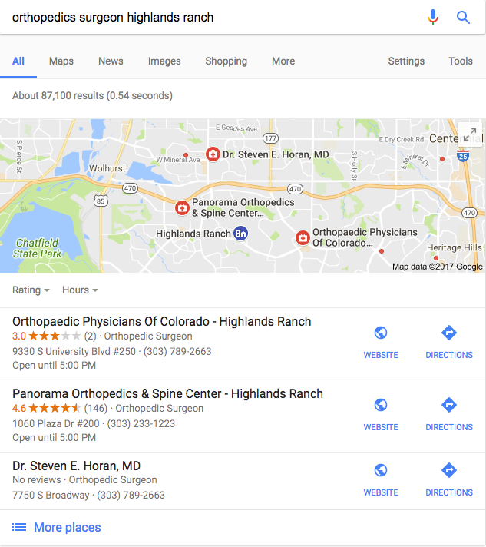
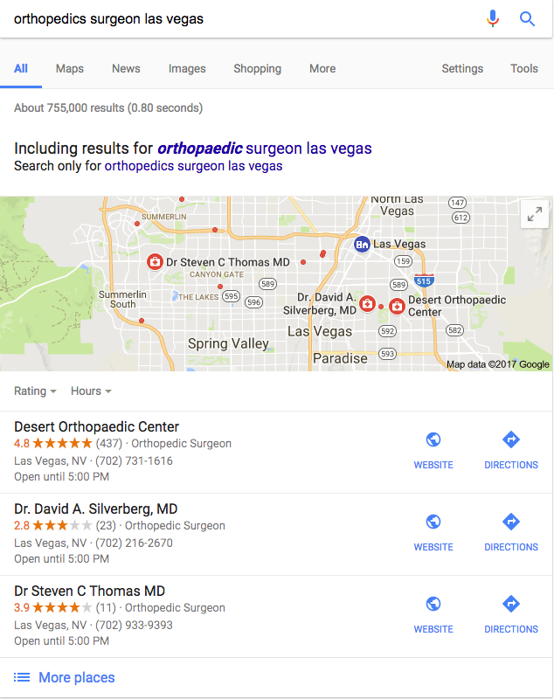
Google

Slide 6
Goals: Transform Your Practice
Social Reviews & Reputation
Improve Operations
Risk Identification & Mitigation

Slide 7
Partner Should Deliver
Automatically – Integrate with EHR/EMR
20+ Reviews per provider monthly
Doctor Report Card – Weekly & Monthly
Service Recovery Tools
Results Tracking
HIPAA Compliant

Slide 8
Benefits You Are Seeking
Get happiest patients to leave reviews
Know instantly when reviews post
Respond centrally to all reviews
Automatically deliver feedback to providers and management
Own your market for Social Reviews

Slide 9
Transform Operations
Know what patients feel
Rank providers
Understand each office’s issues
Track progress monthly

Slide 10
Decrease Risk
Identify risk through data
  3% to 5% of physicians account for 45% to 50% of patient complaints. And, those same physicians account for 50% to 60% of medical malpractice risk. - Dr. William Cooper - Vanderbilt PARS Group
  Identify the providers with the highest risk profile
Transform behavior to decrease risk and Cost
  Consistent reporting starts the behavior transformation
  80% of physicians who received "peer messages," or a peer-to-peer intervention, will self-correct – Vanderbilt Pars Group

Slide 11
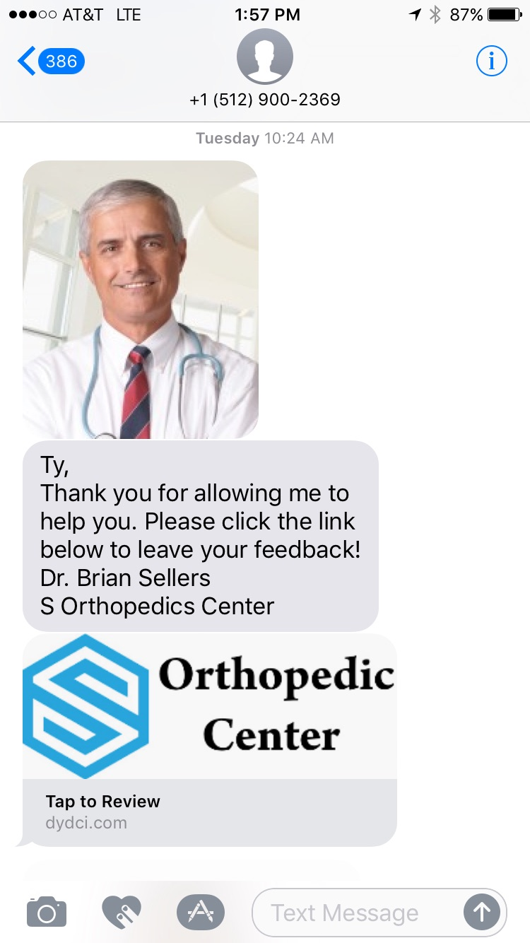
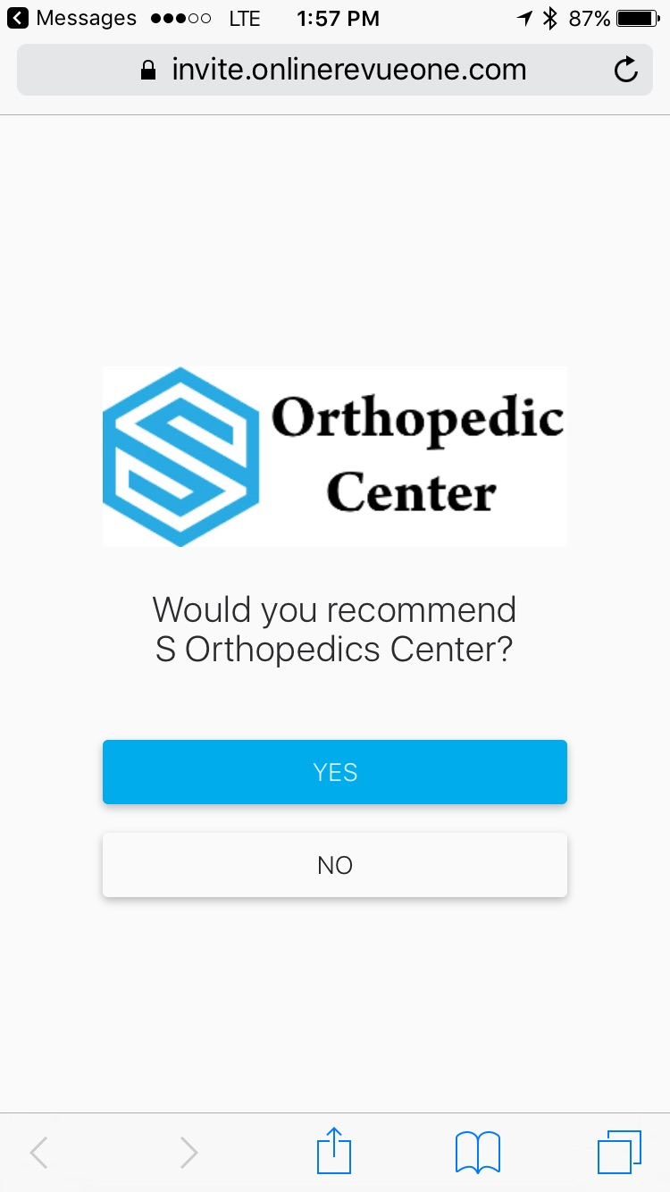
Notes:
A few SocialClime specific items here. We send messages to more than 8,000 new patients for our customer practice per day.
Patient and Provider examples here.

Slide 12
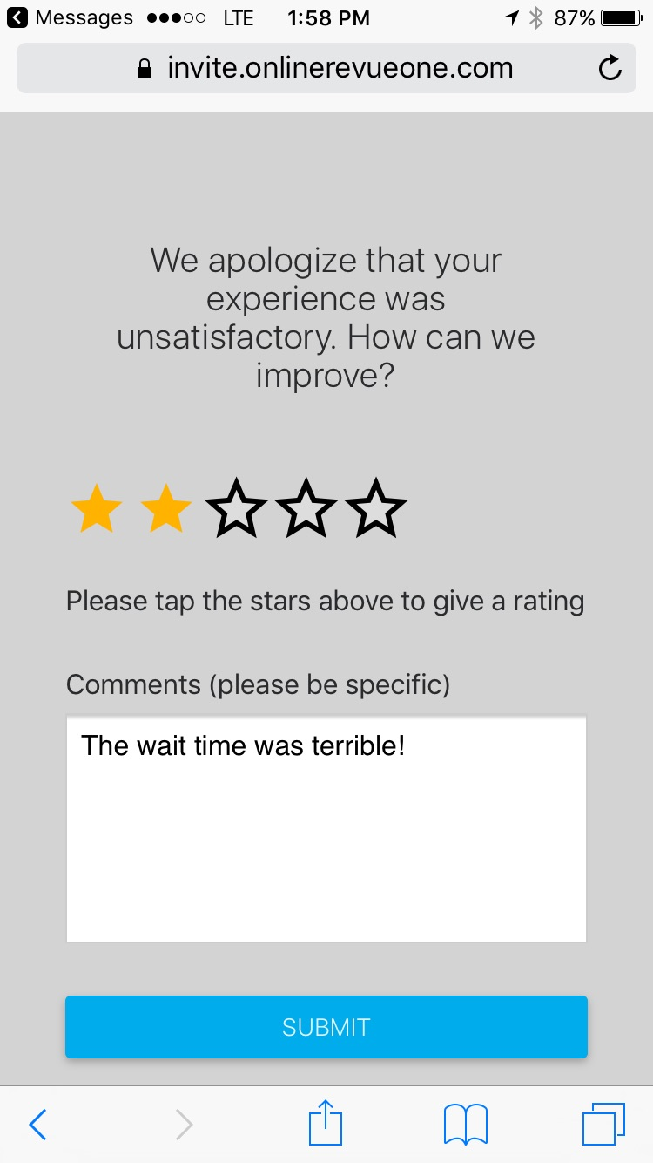

Slide 13
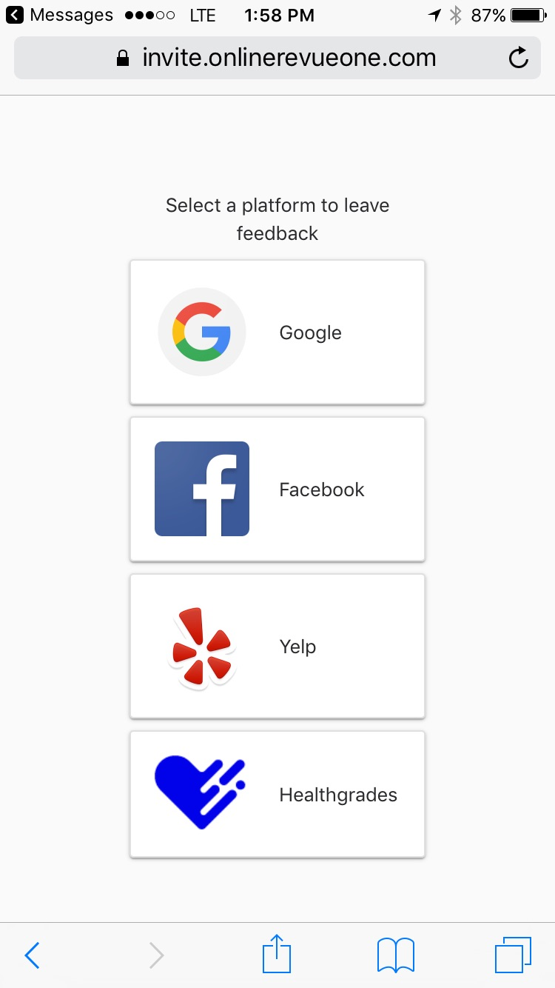

Slide 14
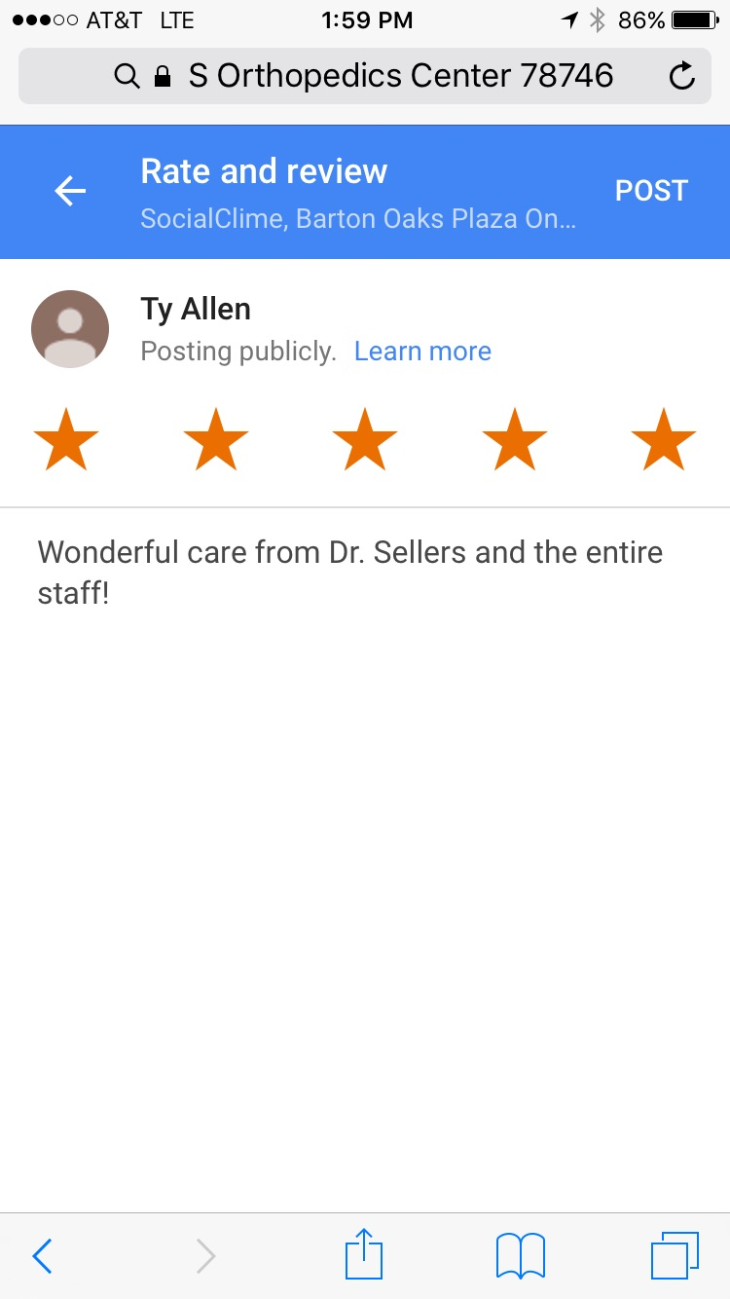
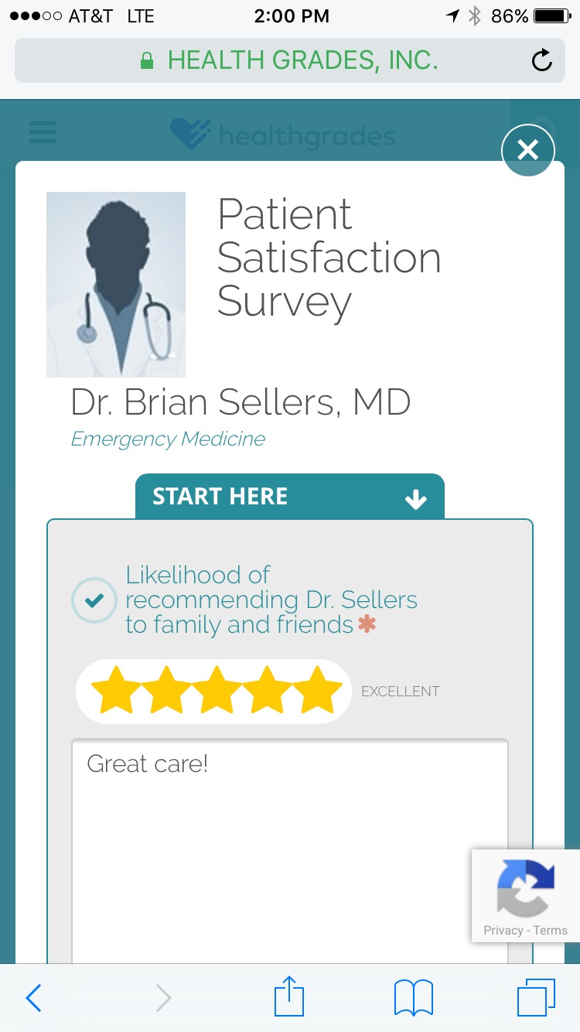

Slide 16
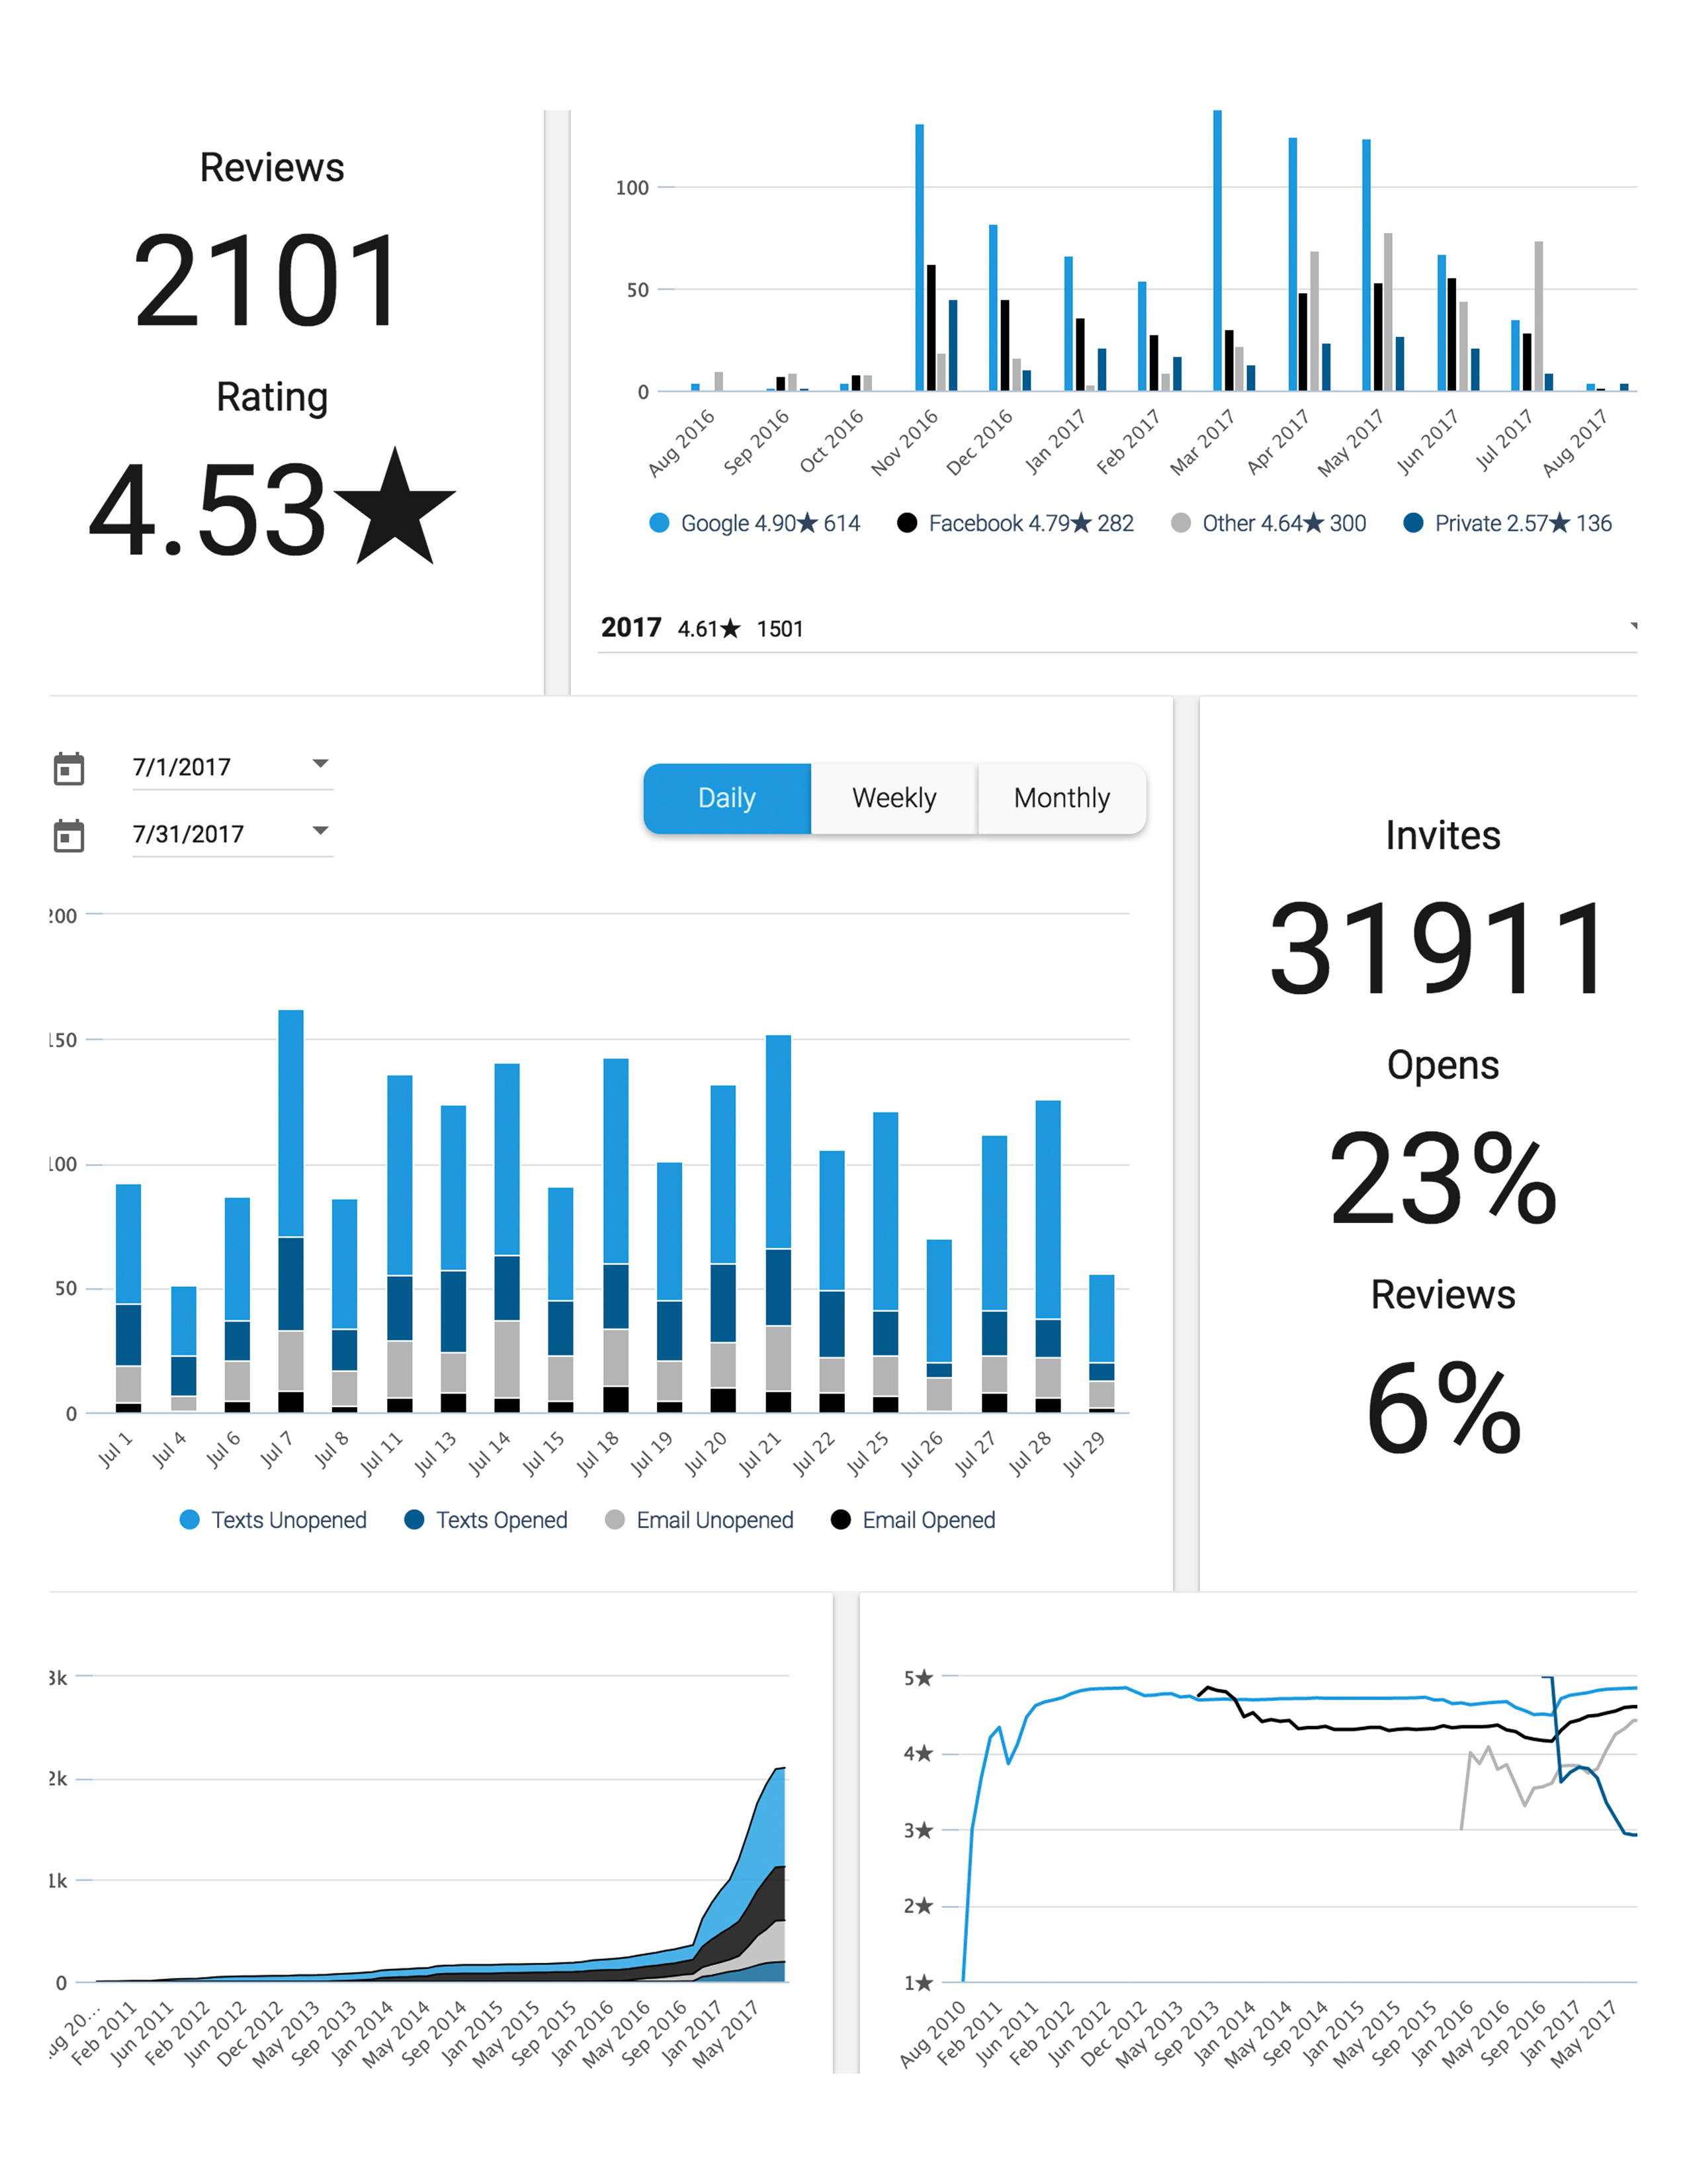

Slide 21





















A Few of Our Customers

